Slide 1


The Future of the Web:
From Cloud to Edge using Server-Side Components, React 18 and Next.js 13
Presented By: Fatima Shahzad
This Photo by Unknown Author is licensed under CC BY-SA-NC

Slide 2






Overview
01
05
Introduction:
Next.js 13
02
06
Emerging Technologies
The Future of Web: Cloud to Edge
03
Server Side Components
04
React 18
Overview of the current state of the web.
Introduction to the main topics of the presentation
Next.js 13 framework for building applications
New features & improvements
Tips for using Next.js 13 in the web projects
Emerging Technologies are shaping the future of web
technologies are driving towards cloud and edge computing
Potential impact of these technologies
Cloud Computing & Role on Web
Edge Computing & differs from Cloud Computing
Benefits of hybrid approach from cloud and edge
07
Security & Privacy
Importance of security and privacy
Challenges and best practices for securing web applications
The role of server-side components in enhancing security and privacy
Server-side Components
How server-side components can improve the performance and scalability of web applications
Examples of server-side components in action
08
Accessibility and Inclusivity
React for building user interface
New features & improvements
Tips for using React 18 in web projects
importance of accessibility and inclusivity
Best practices for building accessible and inclusive
The role of server-side components in improving accessibility & inclusivity
Conclusion

Slide 3

INTRODUCTION
Brief overview of the current state of the web
Introduction to the main topics of the presentation: cloud computing, server-side components, React 18, and Next.js 13

Slide 4

The Future of the Web: From Cloud to Edge
Definition of cloud computing and its role in the web Introduction to edge computing and how it differs from cloud computing The benefits of a hybrid approach that combines both cloud and edge computing

Slide 5
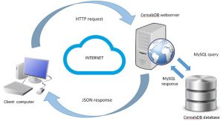
Definition of cloud computing
Cloud computing is the delivery of computing services—including servers, storage, databases, networking, software, analytics, and intelligence—over the Internet (“the cloud”) to offer faster innovation, flexible resources, and economies of scale.
Cloud Computing role in the web

Slide 6
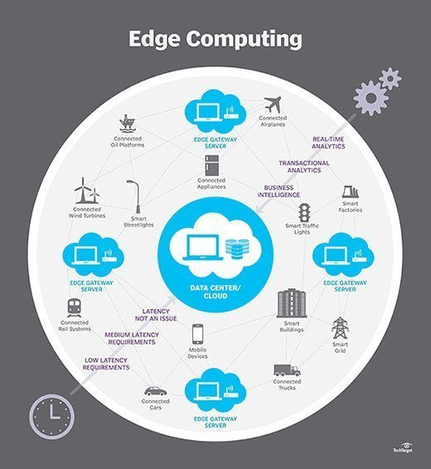
Introduction to edge computing
Edge computing is a distributed computing paradigm that brings computation and data storage closer to the sources of data. This is expected to improve response times and save bandwidth. The term refers to an architecture rather than a specific technology.

Slide 7







Cloud Computing vs Edge Computing
Computation takes place here
VS
Edge Computing
Computation takes place here

Slide 8
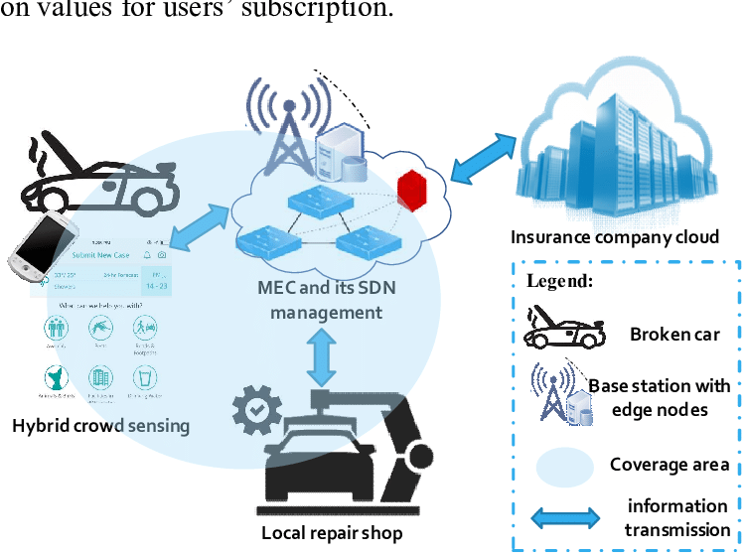
The benefits of a hybrid approach that combines both cloud and edge computing
The primary benefit of a hybrid cloud is agility. The need to adapt and change direction quickly is a core principle of a digital business. Your enterprise might want (or need) to combine public clouds, private clouds, and on-premises resources to gain the agility it needs for a competitive advantage.

Slide 9

Server-Side Components
Definition of server-side components Examples of server-side components in action

Slide 10
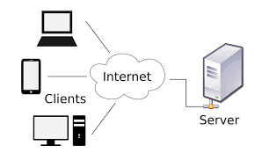
Definition of server-side components
A Server-Side Component consist of a state object, a set of actions and a render function. The typical lifecycle is like this: The component is rendered based as part of a view. Once loaded, elements inside the component, e.g. a button, can call server-side actions using a simple JavaScript library.

Slide 11
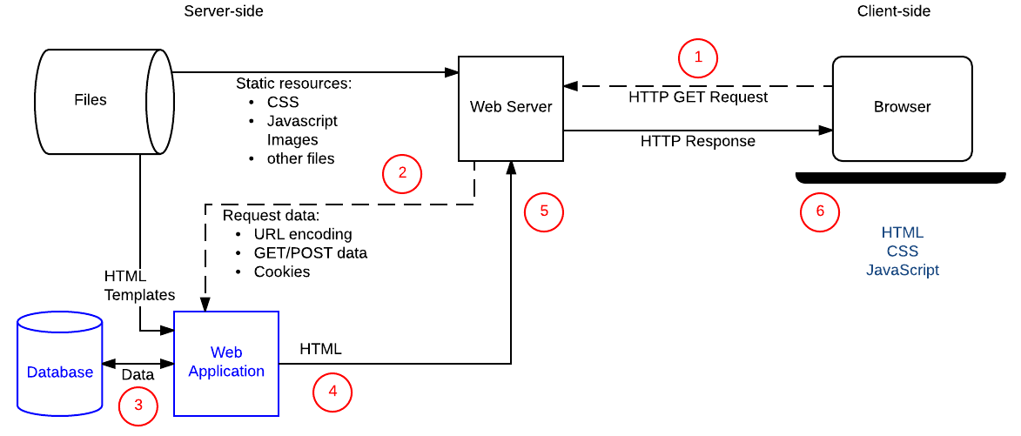
Examples of server-side components in action

Slide 12

React 18
Overview of the React library for building user interfaces Introduction to the new features and improvements in React 18

Slide 13
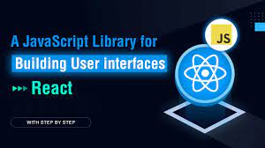
React library for building user interfaces

Slide 14

Introduction to the new features and improvements in React 18
With the new React 18 release, React introduces 'Automatic Batching,' an improved version of batching. Automatic Batching enables batching for all state updates from create Root , regardless of where they originate. This has batch state changes, intervals, native event handlers, asynchronous operations, and timeouts.

Slide 15
Next.js 13
Introduction to Next.js, a framework for building server-rendered React applications Overview of the new features and improvements in Next.js 13 Tips for using Next.js 13 in your web projects
NEXT.js 13

Slide 16
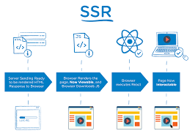
Introduction to Next.js, a framework for building server-rendered React applications
Next.js is a front-end framework that makes it easy to build fast websites with React—which is a free and open-source front-end JavaScript library for building user interfaces based on UI components.

Slide 17
New features and improvements in Next.js 13
App/Directory for File-Based Routing React Server Components Async Components & Data Fetching: Async components, a new method of data collecting for server-rendered components Streaming Turbopack

Slide 18
Accessibility and Inclusivity
The importance of accessibility and inclusivity in the web Best practices for building accessible and inclusive web applications The role of server-side components in improving accessibility and inclusivity

Slide 19
The importance of accessibility and inclusivity in the web
Accessibility: addresses discriminatory aspects related to equivalent user experience for people with disabilities. Web accessibility means that people with disabilities can equally perceive, understand, navigate, and interact with websites and tools. It also means that they can contribute equally without barriers. It is important to keep in mind when designing a website that not every user interacts with it the same way. By using inclusive design, you can remove bias and assumptions from your website and ensure that users do not feel excluded. Read on to learn how to master this modern approach.

Slide 20
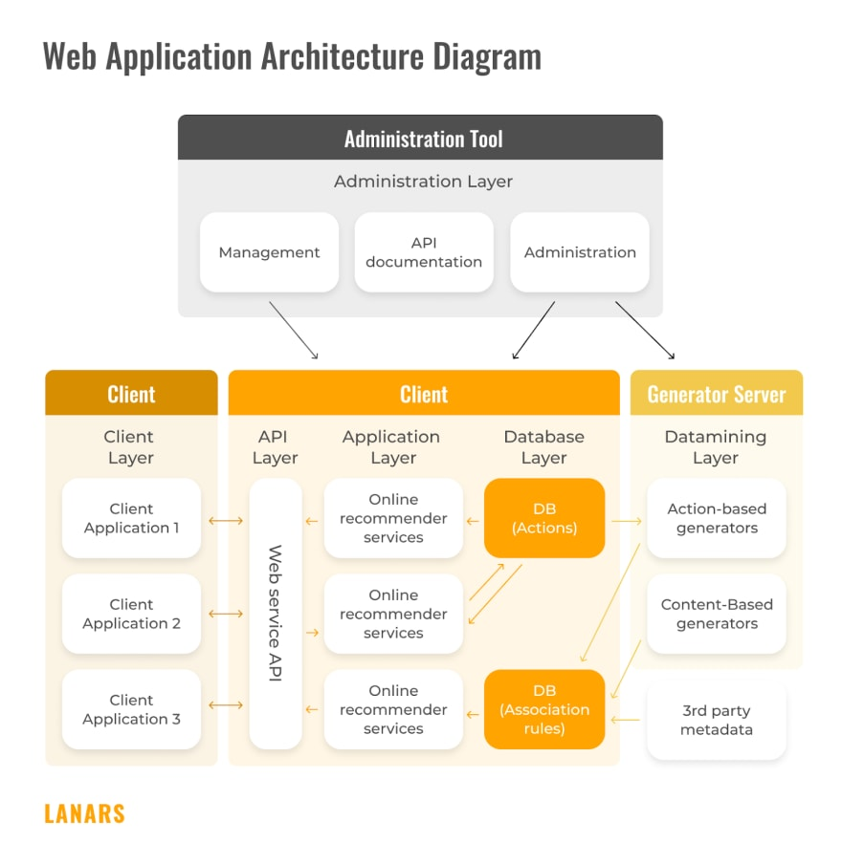
Best practices for building accessible and inclusive web applications
10 best practices for building an accessible web
Use ALT texts for images
Avoid using div for button
Use headings properly
Support Keyboard navigation
Etc.

Slide 21
THANK YOU

